Slide 1
Azure Network

Slide 2
Network and Subnet
.
Network - A computer network is a set of computers connected together for the purpose of sharing resources. A local area network, or LAN, consists of a computer network at a single site, typically an individual office building.
Subnet - A subnetwork or subnet is a logical subdivision of an IP network. Each subnet can be managed separately increasing the security level. It also used to reduce the network traffic or congestion.
Private IP Address - A private IP address is the address space allocated by InterNIC to allow organizations to create their own private network. There are three IP blocks (class A, class B and class C) reserved for a private use. To access the private IP devices from devices residing outside we have to use Route or NAT.
Public IP Address - A public IP address is the address that is assigned to a computing device to allow direct access over the Internet. A public IP address is globally unique, and can only be assigned to a unique device.

Slide 3
Network and Subnet
.
CIDR- Classless Inter-Domain Routing is a method for allocating IP addresses and IP routing. CIDR notation is and combination of address prefix and suffix indicating the number of bits of the prefix. For e.g. 10.0.0.0/24 which have address range of 10.0.0.0 to 10.0.0.256. The count will be derived by the formula 2 ^{(32-N)} .
DHCP - Dynamic Host Configuration Protocol (DHCP) is a client/server protocol that automatically provides an Internet Protocol (IP) host with its IP address and other related configuration information such as the subnet mask and default gateway.
NAT - Network address translation (NAT) is a method of remapping one IP address space into another. Usually a firewall with public address inside a private network allows access to private VMs from internet using the NAT. The main use of NAT is to limit the number of public IP addresses for both economy and security purposes.
Network GateWay - A gateway is a node (router) in a computer network, a key stopping point for data on its way to or from other networks. A network gateway is an internetworking system capable of joining together two networks that use different base protocols.
DNS - The Domain Name System is a naming system for computers, services, or other resources connected to the Internet or a private network.

Slide 4
Azure Network
.
We can create our own Network in Azure with Vnet. It helps to securely connect Azure resources to each other.
The Vnet capabilities
Isolation – Vnets are created with CIDR address blocks. Also we can segment a VNet into multiple subnets.
Name Resolution - Azure provides internal name resolution for VMs and Cloud Services role instances connected to a VNet. We can configure a VNet to use our own DNS servers, instead of using Azure internal name resolution.
Inter Connectivity - VMs and Cloud Services role instances connected to a VNet have access to the Internet, by default.
Intra Connectivity - Azure provides default routing between subnets, VNets, and other networks connected through S2S/ExpressRoute/Peering. So the resources can connect to each other using private IP addresses,
Filter - Network traffic can be filtered inbound and outbound by source IP address and port, destination IP address and port, and protocol.
Routing - Azure's comes with default routing. But we can use our own routes, or BGP routes through a network gateway.

Slide 5
Network Interface (NIC)
.
NIC allows an Azure Virtual Machine (VM) to communicate with Internet, Azure, and on-premises resources. While Creating NIC in Azure we need to provide Virtual network, Subnet and Private IP.
Each VM size has a limit for the total number of NICs from 2 to 8
All network interfaces in a VM must connected to the same VNet.
We can create VM with any number of network interfaces and remove it any time, but the VM should always have at least one network interface.
Since secondary network interfaces aren't assigned a default gateway, they cannot communicate with resources outside of their subnet. Need to add routes to the operating system for secondary NIC.
By default, all outbound traffic from the VM is sent out the IP address assigned to the primary IP configuration of the primary network interface. We can control which IP address is used for outbound traffic within the VM's operating system.
The portal does not allow you to
Attach an existing network interface when creating the VM
Create a VM with multiple network interfaces
Specify a name for the network interface

Slide 6
Public IPs
.
Public IP Address
Used for communication with the Internet, including Azure public-facing services. We can associate the public IP with
Virtual machines (VM)
Internet-facing load balancers
VPN gateways
Application gateways
Dynamic - The default allocation method is dynamic. IP address is not allocated at the time of its creation. Instead, the public IP address is allocated when we start the associated resource. Once we start and stop the associated resource the IP get change.
Static – The IP address is allocated at the time of creation it self and will not change until delete.
Firewall rules written with ip.
DNS name resolution with A records.
Other apps or services that use IP address to communicate.
SSL certificates linked to an IP address.

Slide 7
Private IPs
.
Public IP Address
Used for communication within an Azure virtual network (VNet), and from on-premises network when there is a VPN gateway or ExpressRoute circuit to extend your network to Azure.
VMs
Internal load balancers (ILBs)
Application gateways
Dynamic - The default allocation method is dynamic. IP address is automatically allocated from the resource's subnet (using DHCP). This IP address can change when stop and start the resource..
Static – The IP address is allocated at the time of creation it self and will not change until delete.
Domain controllers or DNS servers.
Resources that require firewall rules using IP addresses..
Other apps or services that use IP address to communicate.

Slide 8
Network Security Group
.
A network security group (NSG) contains a list of security rules that allow or deny network traffic to resources connected to Azure Virtual Networks (VNet). NSG cannot read content it work only with Source/Target IP, Port and Protocol.
NSGs can be associated to
Classic - Subnets, Individual VMs
ARM - Subnets, Individual network interfaces
NSGs Default Tags
VirtualNetwork (VIRTUAL_NETWORK for Classic)
AzureLoadBalancer (AZURE_LOADBALANCER for Classic)
Internet (INTERNET for Classic)
NSGs Default Rules
Virtual network - Both in inbound and outbound directions allowed.
Internet: All Outbound traffic are allowed, but inbound traffic is blocked.
Load balancer: Inbound directions allowed.

Slide 9
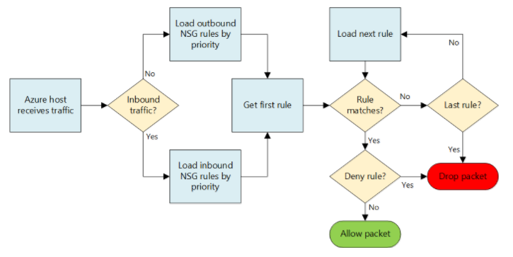
Network Security Group - Flow
.

Slide 10
Azure Load Balancer
Azure Load Balancer is Layer 4 (TCP, UDP) load balancer that distributes incoming traffic among healthy instances of services defined in a load-balanced.
It can be used as
Load Balancer
Port forwarding
NAT
Access Type
Internal Load Balancer – Can only access with in the network or network connected through VPN.
External Load Balancer – Can connect from internet.
Distribution Mode
Azure Load Balancer uses a hash-based distribution algorithm.
5-tuple - Composed of source IP, source port, destination IP, destination port, and protocol type to map traffic to available servers. Non sticky session.
3-tuple - Composed of Source IP, Destination IP, Protocol to map traffic to available servers. It provided Sticky Session
2-tuple - Composed of Source IP, Destination IP to map traffic to available servers. It provided Sticky Session
.

Slide 11
Application Gateway
Microsoft Azure Application Gateway is a layer 7 load balancer for the application. It supports both HTTP load balancing by round robin and Cookie-based session affinity LB. It also have features other than Load balancer as.
Web Application Firewall (WAF) - Protects web applications from common web-based attacks.
Secure Sockets Layer (SSL) offload - This feature takes the costly task of decrypting HTTPS traffic off from web servers.
URL-based content routing – This allows to route traffic to back-end server pools based on URL Paths of the request.
Multi-site routing – We can configure up to 20 web application on the same application gateway instance.
.

Slide 12
Traffic Manager
Traffic Manager uses the Domain Name System (DNS) to direct client requests to the most appropriate endpoint
Routing Method
Priority – Active Passive Model. Need to provide failover time.
Weighted – Round robin with weighted.
Performance – When we have service in multiple regions then according to the latency node will get select.
Geographic - Knowing a user’s geographic region and routing them based on that.
.

Slide 13
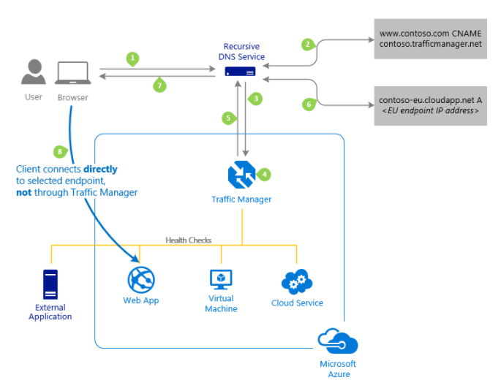
Traffic Manager
.

Slide 14
Azure Load Balancer Comparison
.
Options | Use Case | Advantage | Drawback | Supported Azure Infra
Azure Traffic Manager | • DNS based load balancer. • Well fit for the DR Failover scenario. • We can implement performance based LB and redirect to multiple region | • HA with high availability • DR Can be achieve with minimal SLA. | • Can not be host as internal facing. • Not suit for sticky session (session affinity) load balance. | • Backend Endpoint can be as Azure VMs, Cloud Services, Azure Web Apps, or external endpoints
Azure Load Balancer | • Layer 4 load balancer. • Well fit for basic load balance with in the Azure region. | • No additional Cost involved • Easy and strait forward • Can be host as both internet facing and internal facing. • Supports all protocal | • Not span among regions or public • Not suit for sticky session (session affinity) load balance if client is behind proxy. • It supports network Level not packet level • HTTP endpoint is required for endpoint monitoring | • Backend Endpoint can be as Azure VMs and Cloud Services role instances
Application Gateway | • Layer 7 load balancer. • Well fit for advanced load balance features such as o cookie based session affinity o URL path based routing o Host multiple websites behind a single AG. o SSL Offload. • It comes with web application firewall (WAF) | • Span among regions or public • Well suit for sticky session (session affinity) load balance if client is behind proxy. • Can be host as both internet facing and internal facing. | • Additional Cost involved • Only supports protocal HTTP, HTTPS and WebSockets | • Backend Endpoint can be as Any Azure Internal IP address or public internet IP address

Slide 15
Azure Network Connectivity
.
We can connect several resources like Vnet, On-Premises Network, VMs, Physical machines and etc. With Azure VNet.
Connect Azure Virtual Networks
Peering – To connect different Azure VNets within the same Azure location.
VNet-to-VNet - To connect different Azure VNets belongs to different Azure location.
Connect On-Premises Networks
Point-to-site - To connect single PC with any VNet.
Site-to-site - To connect Azure VNets and On-Premises Network through the internet. The connection is an IPSec/IKE VPN that provides encrypted communication over the Internet between your on-premises device and the Azure VPN gateway. Not a dedicated connection.
Azure ExpressRoute- To connect Azure VNets and On-Premises Network through a dedicated line.

Slide 16
Azure VPN Gateway
.
It is a type of virtual network gateway that sends encrypted traffic across a public connection to other Network which may resides on on-premises or other cloud providers.
New VPN Gateway Types
Policy-Based (Static routing) VPNs – Policy-based VPNs encrypt and route packets through an interface based on a customer-defined policy. The policy is usually defined as an access list. Static routing VPNs require a static routing VPN gateway.
Route-Based (Dynamic routing ) VPNs – Route-based VPNs depend on a tunnel interface specifically created for forwarding packets. Any packet arriving on the tunnel interface will be forwarded through the VPN connection. Dynamic routing VPNs require a dynamic routing VPN gateway.

Slide 17
Azure VPN SKU
.
New VPN Gateway SKU
VpnGw1 – Route-based VPN. We can get up to 500 Mbps throughput.
VpnGw2 – Route-based VPN. We can get up to 1 Gbps throughput.
VpnGw3 – Route-based VPN. We can get up to 1.25 Gbps throughput.
Basic – Route/policy-based. We can get up to 100 Mbps throughput.
We can configure "PolicyBasedTrafficSelectors" to connect a route-based VPN gateway (VpnGw1, VpnGw2, VpnGw3) to multiple on-premises policy-based firewall devices.
Old VPN Gateway SKU
Basic – Route-based and Policy-based VPN. We can get up to 100 Mbps throughput.
Standard – It supports only Route-based VPN. Policy-based VPNs are not supported. We can get up to 100 Mbps throughput.
High Performance – It supports only Route-based VPN. Policy-based VPNs are not supported. Active-active is supported using BGP Setup. We can get up to 100 Mbps throughput.

Slide 18
Network Security
.
IPS (Intrusion Prevention Systems)
We can configure "PolicyBasedTrafficSelectors" to connect a route-based VPN gateway (VpnGw1, VpnGw2, VpnGw3) to multiple on-premises policy-based firewall devices.
IDS (Intrusion Defense Systems)

